Slide 1
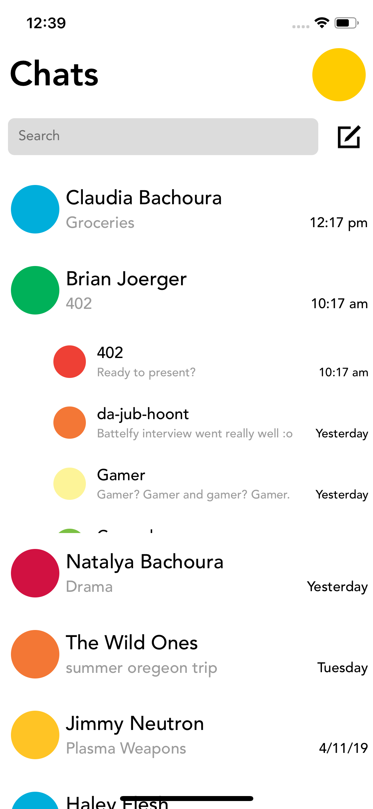
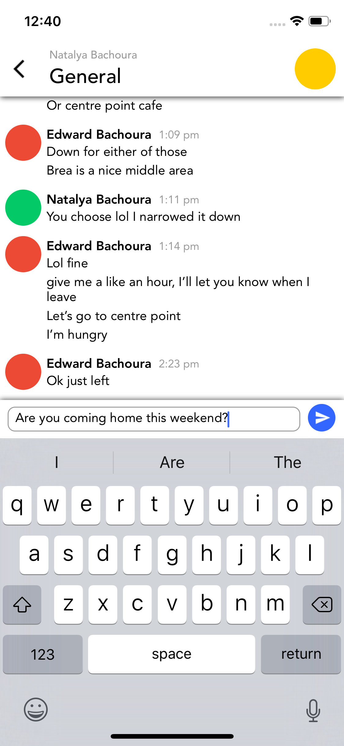
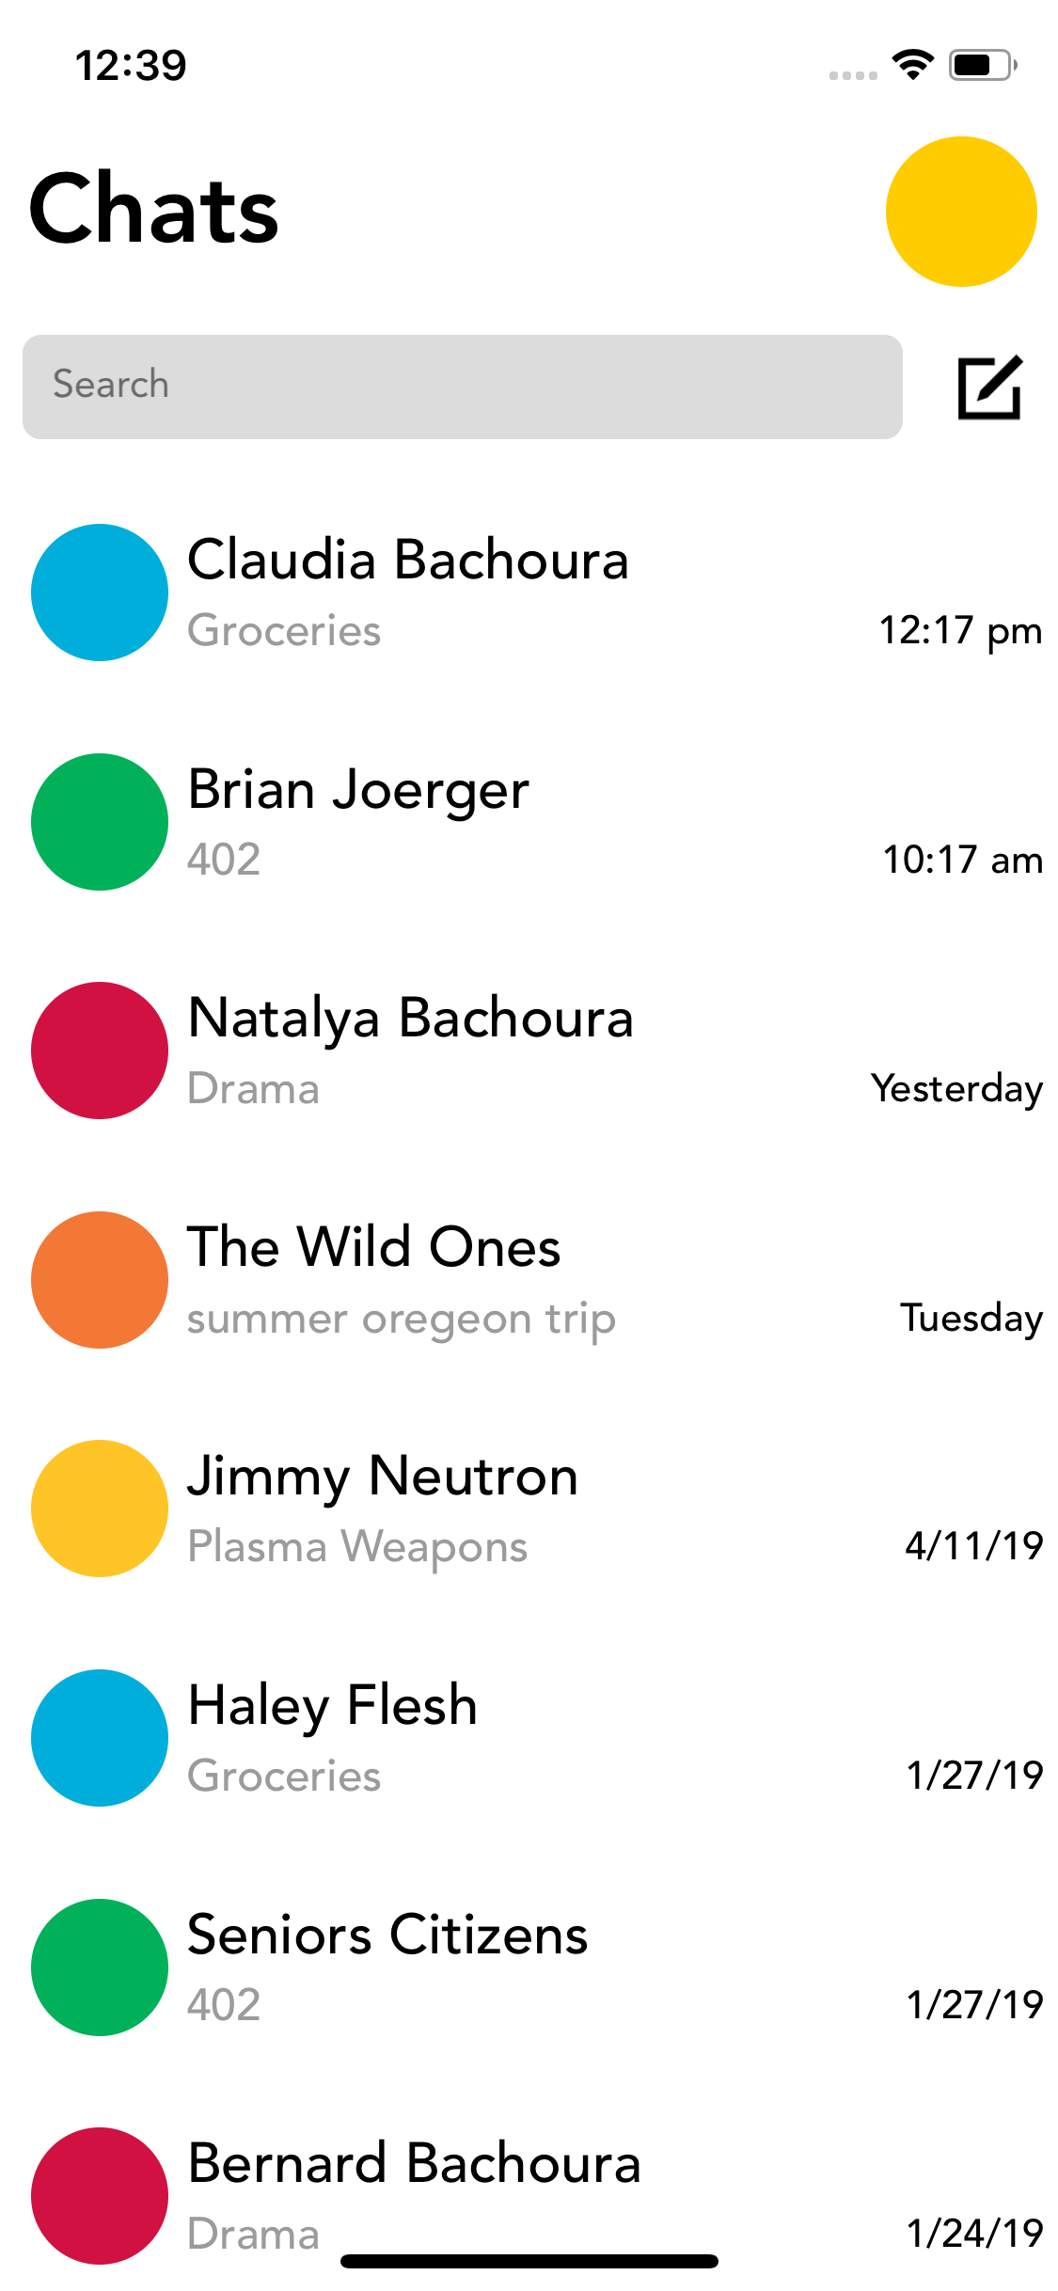

Circles
Frontend:
Why make ANOTHER MESSAGING APP?
Although there are already so many messaging apps out there, we believe that Circles deserves to stand among them. The user experience offered by Circles is unlike any other, and could easily compete with other more basic and boring casual messaging applications.
React Native
Edward Bachoura and Brian Joerger
Spring 2019 – Senior Project Laboratory
https://github.com/edward-and-brian/circles
Typescript
Apollo GraphQL
Backend:
Goals
Making a full stack application from scratch in the timespan of a semester proved to be a very difficult task. That being said, we are very pleased with how far we have come with Circles. However, in order to truly be a complete messaging app, there are a lot of things that still can be done to improve performance, incorporate expected functionality, guarantee security, and improve the user experience altogether. The list of things we want to include is an ever-growing list, and so we plan to continue this project in our free time, and hopefully get it on the App Store. At the very least, this project is providing us with plentiful application development experience.
GoLang
GraphQL
SQLite
Circles is a messaging application which boasts a simple and lightweight design like iMessages and Messenger. However, unlike those apps, Circles incorporates a unique organizational structure that we call “circles”, of course. We believe that this compilation of original and tried-and-true design will create an amazing user experience.
Post MVP
Open sockets for live updates
Retrieve contacts from phone
Add animations to spice app
Move message data to Redis
GraphQL Loaders? Caching.
Authentication & Authorization
Store images/videos in buckets
Publish to Play Store and App
Store & deploy server

